Slide 1
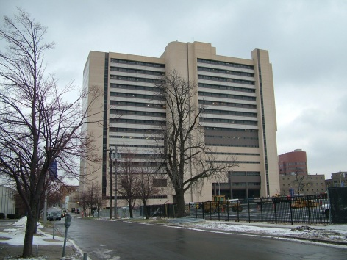
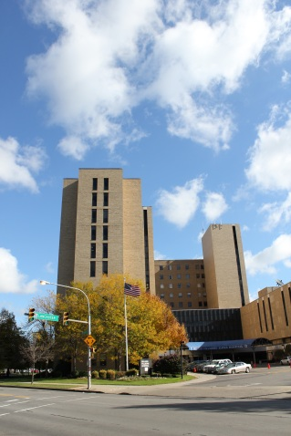
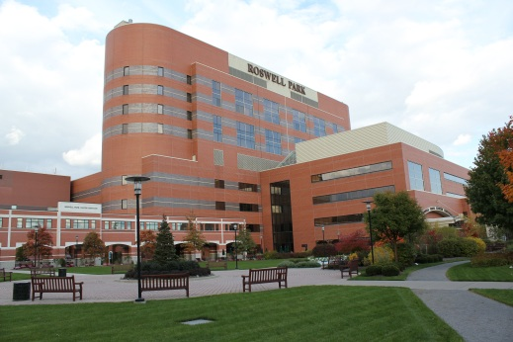
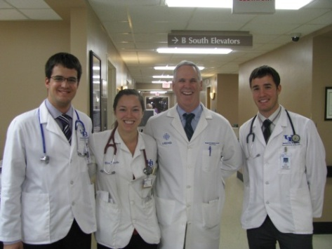
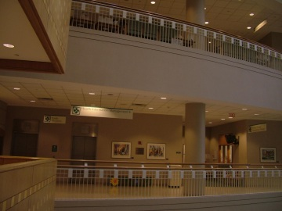
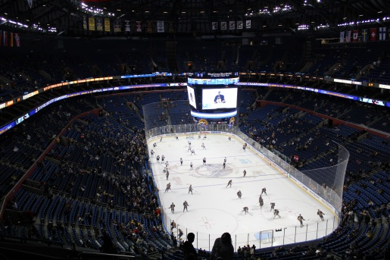
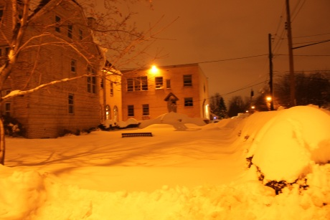
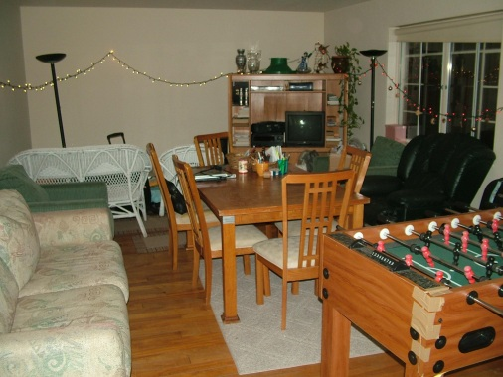
6TH YEAR EXCHANGE PROGRAM IN BUFFALO
12 week credit-bearing senior elective program
Available for any 6th year rotation subject (please find detailed list of subjects on website)
4 program dates: July- September, 2016; September- November, 2016; December- February, 2016-2017; March- May, 2017
Housing in Buffalo and tuition fee is provided by Hungarian Medical Association of America
Additional reductions available via Professional Internship Program of HAESF (for further information please visit www.haesf.org)
____________________________________________________________________
Application form available on HMAA and POTE websites
(www.hmaa.org and www.pote.hu)
Program is available to those Hungarian medical students who have started their 5th year in September, 2015.
Please note that TOEFL certificate is required for application!
DEADLINE: January 19th, 2016
____________________________________________________________________
SPEND YOUR 6TH YEAR ROTATION IN BUFFALO!
____________________________________________________________________
For further information please contact:
Andrea Horvath: andrhorvath@gmail.com
Anna Budai: budaianna88@gmail.com
Zsofia Nozomi Karadi: zsofia.karadi@gmail.com
Gabor Horvath: figgol@hotmail.com
Bálint Környei: kornyei.balint@windowslive.com
www.hmaa.org
www.haesf.org

